Slide 1
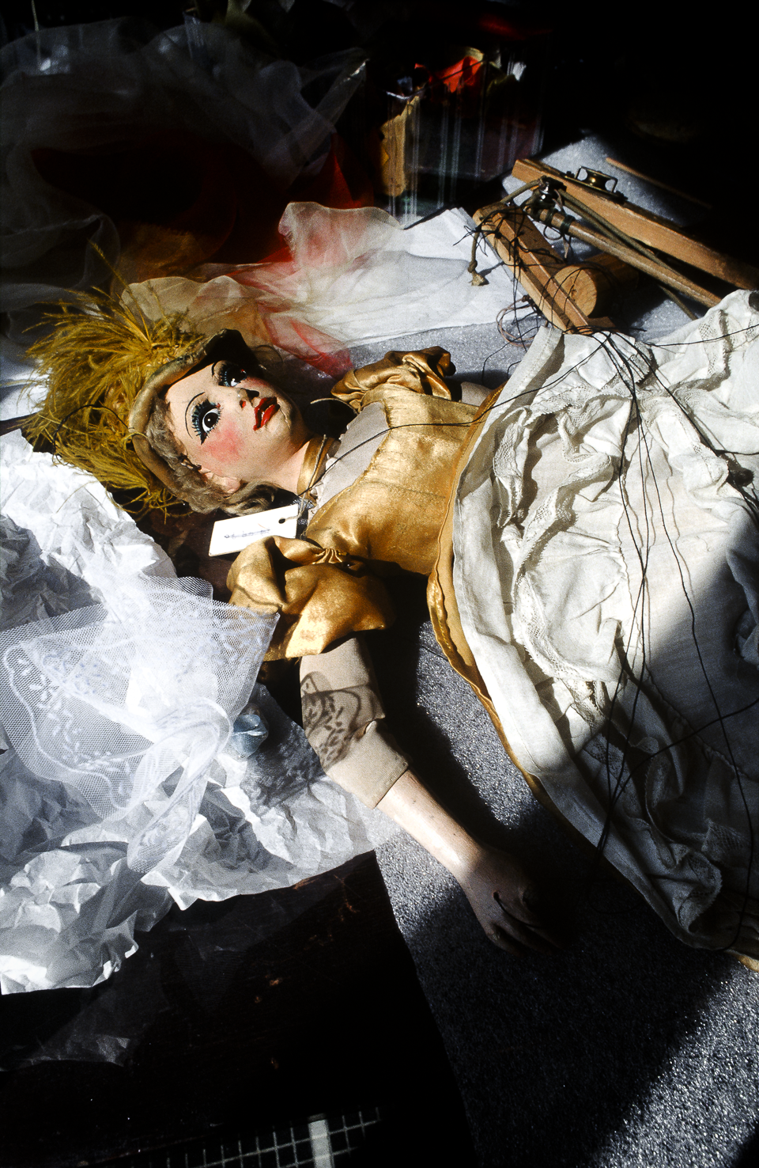
portraits monographs abstract upcoming author contact home
photography
Anything can be a source of inspiration for my photographs
making:
Parisian culture and civilization,
wine,
Italian landscapes and Venetian architecture,
New York Village Halloween Parade,
nature,
the fate of man, its suffering and death.
Etc.
Nevertheless, the human face has been – and remains – an
important part of the <matrix> for my various portraits,
which comprise the major part of my work.
Andrew Aitch
Marionnette, Paris, 2001
All rights reserved. Copyright 1982 – 2018 Andrew AITCH

Slide 2
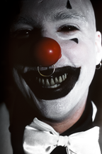

AITCH
portraits monographs abstract upcoming author contact home
Who Are You?
New York’s Children
By Marry, Be Happy
But, if you had it, you would give it to me?
Diverse
text
back
next
Clown, NYC, 2006

Slide 3
AITCH
portraits monographs abstract upcoming author contact home
Who Are You?
New York’s Children
By Marry, Be Happy
But, if you had it, you would give it to me?
Diverse
text
back
next
xxxxxxxxxxxxxxxxx

Slide 4
AITCH
portraits monographs abstract upcoming author contact home
Who Are You?
Andrew Aitch
Who Are You?
New York’s Children
By Marry, Be Happy
But, if you had it, you would give it to me?
Diverse
text
back
next

Slide 5
AITCH
portraits monographs abstract upcoming author contact home
Who Are You?
New York’s Children
By Marry, Be Happy
But, if you had it, you would give it to me?
Diverse
text
back
next
xxxxxx, xxxxxxxxxx

Slide 6
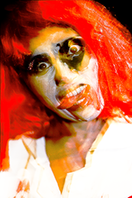
AITCH
portraits monographs abstract upcoming author contact home
Who Are You?
New York’s Children
By Marry, Be Happy
But, if you had it, you would give it to me?
Diverse
text
back
next
xxxxxx, xxxxxxxxxx

Slide 7
AITCH
portraits monographs abstract upcoming author contact home
Who Are You?
New York’s Children
By Marry, Be Happy
But, if you had it, you would give it to me?
Diverse
text
back
next
xxxxxx, xxxxxxxxxx

Slide 8
AITCH
portraits monographs abstract upcoming author contact home
Who Are You?
New York’s Children
By Marry, Be Happy
But, if you had it, you would give it to me?
Diverse
text
back
next
xxxxxx, xxxxxxxxxx

Slide 9
AITCH
portraits monographs abstract upcoming author contact home
Who Are You?
New York’s Children
By Marry, Be Happy
But, if you had it, you would give it to me?
Diverse
X
text
back
next
xxxxxx, xxxxxxxxxx

Slide 10
AITCH
portraits monographs abstract upcoming author contact home
X
X
X
The Appearances
Wine
Red Rock
text
back
next
xxxxxx, xxxxxxxxxx

Slide 11
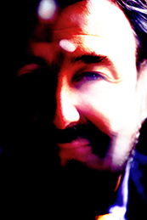
AITCH
portraits monographs abstract upcoming author contact home
X
X
X
The Appearances
Wine
Red Rock
text
back
next
xxxxxx, xxxxxxxxxx

Slide 12
AITCH
portraits monographs abstract upcoming author contact home
X
X
X
The Appearances
Wine
Red Rock
text
back
next
xxxxxx, xxxxxxxxxx

Slide 13
AITCH
portraits monographs abstract upcoming author contact home
X
X
X
X
X
X
text
back
next
xxxxxx, xxxxxxxxxx

Slide 14
AITCH
portraits monographs abstract upcoming author contact home
X
X
X
X
X
X
text
back
next
xxxxxx, xxxxxxxxxx

Slide 15
AITCH
portraits monographs abstract upcoming author contact home
X
X
X
X
X
X
text
back
next
xxxxxx, xxxxxxxxxx

Slide 16
AITCH
portraits monographs abstract upcoming author contact home
X
X
X
Veneziana
Rectangular Rhapsody
I Persist …
text
back
next

Slide 17
AITCH
portraits monographs abstract upcoming author contact home
X
X
X
Veneziana
Rectangular Rhapsody
I Persist …
text
back
next
xxxxxx, xxxxxxxxxx

Slide 18
AITCH
portraits monographs abstract upcoming author contact home
X
X
X
Veneziana
Rectangular Rhapsody
I Persist …
text
back
next
xxxxxx, xxxxxxxxxx

Slide 19
AITCH
portraits monographs abstract upcoming author contact home
X
X
X
X
X
X
text
back
next
xxxxxx, xxxxxxxxxx

Slide 20
AITCH
portraits monographs abstract upcoming author contact home
X
X
X
X
X
X
text
back
next
xxxxxx, xxxxxxxxxx

Slide 21
AITCH
portraits monographs abstract upcoming author contact home
X
X
X
X
X
X
text
back
next
xxxxxx, xxxxxxxxxx

Slide 22
AITCH
portraits monographs abstract upcoming author contact home
X
X
X
New Yorkers
New York’s Artists
Dei ricordi italiani
text
back
next
xxxxxx, xxxxxxxxxx

Slide 23
AITCH
portraits monographs abstract upcoming author contact home
X
X
X
New Yorkers
New York’s Artists
Dei ricordi italiani
text
back
next
xxxxxx, xxxxxxxxxx

Slide 24
AITCH
portraits monographs abstract upcoming author contact home
X
X
X
New Yorkers
New York’s Artists
Dei ricordi italiani
text
back
next
xxxxxx, xxxxxxxxxx

Slide 25
AITCH
portraits monographs abstract upcoming author contact home
X
X
X
X
X
X
text
back
next
xxxxxx, xxxxxxxxxx

Slide 26
AITCH
portraits monographs abstract upcoming author contact home
X
X
X
X
X
X
text
back
next
xxxxxx, xxxxxxxxxx

Slide 27
AITCH
portraits monographs abstract upcoming author contact home
X
X
X
X
X
X
text
back
next
xxxxxx, xxxxxxxxxx

Slide 28
AITCH
portraits monographs abstract upcoming author contact home
His Life
Born in Poland, under communist rule, Andrew Aitch was edu-cated by his family in the Francophile and Occidental traditions, political and artistic. It marked all his personal and professional life. Attracted since his childhood by every expression of image, from drawing to cinema, by approach theoretical versus practice, he found as adult his own way: to devote solely to photography,
to its creation. This so important decision for his future was taken after having studied the history of culture at Poznan University
and the semiology at the University of Sorbonne in Paris. It was the mid-eighty. At this time starts his life, as he likes repeat, in Paris, his adopted home. Then he took a two years photography course at the French Society of Photo- graphy in the Workshop
of Professor Jean-Yves du Barré completed by photojournalistic training in the School of Journalism. Next step was his photo- graphic work for different private, public, and government French institutions crowned by an engagement as assistant professor,
still in photographic domain, in Ecole Supérieure des Arts Déco-ratifs in Paris. Afterwards he became an independent photographer, primarily interested in fine art photography, fully at the beginning of his new, American life in New York City since 2002.
Andrew Aitch is a highly versatile photographer who masters the most varied subjects, ranging from documen- tary to abstract approach. His artistic work can illustrate significantly, better than other source, his Euro-pean origin, his scholar, artistic and general knowledge, his openmin-ded experimentation with different me- thods, and finally his style with two dominant components, French, “classical” and Slavonic, “romantic-expressionist”.
Numerous of his photographs were exhibited by well known French, Polish and American galleries and museums: French Society of Photography, Roi Doré, Museum Natio-nal in Warsaw, The Polish Institute of Arts and Sciences of America, Soho Photo and Bruce Silverstein in New York etc. Parisian Mois de la Photo and other European festi-vals,newspapers and magazines pub- lished his “Portraits” and some of his monographs. National Museum in Warsaw, Museum of Contemporary Art in Lodz, Centre National de la Photographie in Paris, The New York Public Library and many private collectors possess his works. Andrew Aitch was awarded and granted by universities fellowships, French Govern-ment, Foundation Michel Salomon Radochitzki, Paris Council and Ministry of French Foreign Affairs. Since 1990 he has been a member of the Société Française de Photographie.
Elaborated by Anne Sophie Wolska
Biography
Resume
Statement
back
next

Slide 29
AITCH
portraits monographs abstract upcoming author contact home
ANDREW AITCH SERA CHANGE
Born Andrzej Haladuda
American photographer of European descent residing and working
in Paris and New York
9 Vogel Lane
Staten Island, New York 10314, USA
+ 1 718 815 39 16
andrewaitchusa@gmail.com
www.andrewaitch.com
Education
1976 Master in History of Culture, Poznan University, Poland
1984 Master of Advanced Studies in Visual Semiology, University of Sorbonne, Paris
1990 Professional Diploma of Photography, Academy of Paris
1991 Diploma of Photography, French Society of Photography, Jean Yves du Barré’s Atelier, Paris
Photojournalism Certificate in School of Journalism, Paris
Career History
1984 -1993 Photographer for different private, public and
government institutions (e.g. in Conseil Général Val
d’Oise), France
Since 1999 Freelance photographer in Paris and New York
Teaching
1976 -1982 Assistant Professor at the Academy of Pedagogical
Sciences in Zielona Gora, Poland
1994 -1995 Assistant Photographer in Professor André
Rochefort’s Workshop in Ecole
Nationale Supérieure des Arts Décoratifs in Paris,
France
1995 -1997 Instructor Photographer at Ecole Nationale
Supérieure des Arts Décoratifs in Paris, France
1997 -1998 Assistant Professor at the Academy of Fine Arts in
Poznan, Poland. Organizer and Supervisor of
Documentary Photography Workshop at
the Academy of Fine Arts in Poznan, Poland
Area of intrest
Fine Art Photography, Portrait
Social Documentary and Anthropological Photography
Abstract Photography
Exhibition Design
Selected group exhibitions
1991 Photographers of French Society of Photography, SFP Gallery, Paris
1998 First Biennial of Polish Photography, Galeria u Jezuitow, Poznan
1999 Polish Photography in the World, The Polish Association of Photographers
Szczecin, Warsaw, Paris, Berlin and New York
2000 10ème Mois Bis de la Photo, Espace Saint Martin, Paris
2005 Jesus Christ Superstar, 50 years of Jesus Christ in
photography, Bruce Silverstein Photography, New York
2008 Members’ Group Show, Soho Photo Gallery, New York
2009 VII Biennale d’Art Sacré, Confuences, Lyon
2012 17ème Mois de la Photo, Galerie Roi Doré, Paris
2014 Photographie, traces d’une époque et d’une émotion, Galerie Roi Doré, Paris
Selected solo exhibitions
1990 French Gardens, French Trade Exhibition, Paris
1996 In Poznan Artist’s Workshops, Galeria Pod Arsenalem, Poznan
1997 Essais Parisiens, Philadelphia International Institute, PII Gallery, Philadelphia
Photography Memories, Annual Photography Exhibition, Broadway, New York
1998 Ce n'est qu'un au revoir, Le Pont Neuf, Paris
Paris Impressions, U Jezuitow Gallery, Poznan
1999 Assemblages for New York, Philadelphia International Institute, P II Gallery, Philadelphia
2000 Big Apple Pie, The Consulate General of the Republic of Poland, New York
Un jour j’irai à Paris..., The Polish Institute of Arts and Sciences of America, New York
2002 The Appearances, National Museum, Warsaw
2005 Wine, The Polish Institute of Arts and Sciences of America, New York
2009 Halloween, Soho Photo Gallery, New York
2011 Parisian Motifs, Part I, Soho Photo Gallery, New York
2012 Parisian Motifs, Part II, Galerie Roi Doré, Paris
2013 Venetian Motifs, Soho Photo Gallery, New York
Selected photographic monographs and series
Since 1984 Polish Artists, portraits
1990 French Gardens, historical research on French
decorativeness
1991 Musée d’Orsay in Paris, documentary essay about
Gae Aulenti’s design
1993 - 2015 Jan Lebenstein, digital painting for the portraiture
of famous Polish artist
Since 1993 Polish Presence, portraits of Poles and French of
Polish origin having outstanding achievements in
various social fields, especially in science and art
of contemporary France
1995 Bois de Boulogne, photojournalistic inquiry on all
kind of social activity in this Parisian area
1995 - 1996 In Theirs Workshops, portraits of Poznan’s artists
1995 - 1997 Big Apple Pie, New York City depicted by the
method of “multi-exposure of one negative”
Photography Memories, derived from previously
cited monograph
1995 - 1997 Un jour j’irai à Paris..., images of Paris created
using the same, “multi-exposure method”
Essais Parisiens and Paris Impressions derived
from above monograph
Since 1994 Halloween, portraits of participants of New York
Village Halloween Parade
1996 - 2014 I am a Mother!, portraits
1997 L’Ambroisie, reportage photographic about
Bernard Pacaud’s world-renowned restaurant
1999 - 2002 The Appearances, anthropological study designed
and made to discover and interpret fundamental
key concepts of French culture and civilization
exemplified in Paris
1999 - 2014 Parisian Motifs, derived from previously cited
monograph
1999 - 2009 Golem, anthropological treatise about “Free Will”,
the notion of liberty which, it seems, one have
been given …
1999 - 2014 Wine, illustration as a tribute to “Wine” realized in
Philippe Faure-Brac’s Parisian wine cellars
1999 - 2014 Lament, philosophical treatise about the human
fate irrevocably assigned.
2000 Ecce Homo, derived from previously cited
monograph
Since 2001 The Frontier, various research about New York
real and imaginary
2002 Hôtel Biron, poetic study of Auguste Rodin’s art in
his Parisian workshop
Since 2002 Nature, Images of American National Parks
implemented in the aesthetics of the landscape
category
Since 2002 New York’s Children, portraits
Since 2002 Newyorkers, portraits
Since 2002 Dei ricordi italiani, anthropological study about
fundamental key concepts of Italian culture and
civilization
2004 - 2008 Venetian Motifs, derived from previously cited
monograph
Since 2003 Be Marry, Be Happy …, portraits of participants of
Gay Pride Parades and other social events in New
York City having noticeable presence of
homosexual community
2004 - 2014 Veneziana, one of the examples of the geometric
abstraction built using venetian visual reality
Since 2005 Still Lifes, diverse research concerning the
decorative potential of photography
Since 2005 Colors, various pictorial research on the abstract
photography
2008 ”But, if you had a cig, you would give it to me?”,
Portraits of mental patients somewhere in Europe
Works in the collections
In Poland
Center of Contemporary Art, Warsaw
Gallery R, Poznan
Museum of Contemporary Art, Warsaw
Museum of Art, Lodz
National Museum, Warsaw
In France
Carnavalet, Paris
Centre National de la Photographie, Paris
French Society of Photography, Paris
Galerie Roi Doré, Paris
Paris Council
Musée Rodin, Paris
In the United States of America
The Kosciuszko Foundation, New York City
Metropolitan Museum of Art, New York City
The New York Public Library, New York City
The Polish Institute of Arts and Sciences of America, New York
Whitney Museum, New York City
Private European, American and Chinese collections
Awards, grants, and fellowships
1976 Fellowship for the Arts awarded by Poznan University
Academy of Pedagogical Sciences Grant for Cinema
Studies at University of Lodz and Film School in Lodz
1981 French Government Grant for Semiological Studies in Academy of Paris
1998 Foundation Michel Salomon Radochitzki Grant
1991 French Society of Photography Award for monograph “Design du Musée d’Orsay”
1999 Fellowship for project “The Appearances” awarded by Paris Council
2002 French Ministry for Foreign Affairs’ Grant for the exhibition “The Appearances” in National Museum in Warsaw
Membership
Since 1990 Member of French Society of Photography
Biography
Resume
Statement
back
next

Slide 30
AITCH
portraits monographs abstract upcoming author contact home
My Images
Statement of Artistic Philosophy
Everything visual has always been fascinating to me and present
in all aspects of my life, from my drawing practice to my theoretical studies in semiology of film. The images in its mani-festations so different, unique and real, were for me an object of desire, to study as completely as possible and at the same time to achieve. These two complementary approaches, the theore- tical versus practice has proven to be most fruitful for my entire artistic work, especially for my photography which, for many decades already, has been both: my profession and my expression of art.
Nevertheless, it is freedom, as an essential axiom, that has formed the basis of my artistic philosophy. In fact, I have always felt a need to act independently without being subjected to do-minant ideas. I remain firmly convinced that "the style is the man" as Bossuet said, and therefore my images should document the metamorphosis of my life in a world within the world of my images. Obviously, they do, they record my traces, the traces of my present American existence, the traces of my French and Polish origins, of my family heritage and those of my artistic journey. All of these encompass two main, deeply personal topics obsessively recurring in my work: ___my joy of life, glorification of life and its beauty, pleasure, de-sire, freedom ... and, ___my existential despair, my deep dissension on Man's fate, on the fragility of mankind, suffering, determinism and death. The photographic image is my means of expression and my art, but
I do not feel trapped within its borders, neither ontologically nor aesthetically. On the contrary, nonconformist experimentation is part of my credo as an artist. In my achievements, the pure pho-tography, traditional or digital co-exist together with the mixed media, the objective documentary co-exist with sensual abstrac-tion etc. It is not contradictory because these are my heteroge-neous ideas and diverse dreams that dictated to me such vast choice of technological and stylistic approaches. Take, for example, the two typical case studies from my photographic work. Although they represent two extremely opposite, aesthetic positi-ons, both are significant trends of my "philosophy": ___ "The Appearances", anthropological treated on the key concepts of the French culture and civilization, classical work, similar to the new realism, and ___ "Halloween," caricatures of participants from New York Village Halloween Parade, expressionist work par excellence.
The realization of the images and particularly their creation has been the most exhilarating and exciting part of my life. My images represent the best of my work - emerging spiritually and materia-listically - from everything I have done in my life. They give mea-ning to my life, affirm my existence, my artistic and philosophical self, above all else. Apparently, they provide me with the means to study and to interpret a reality, that the outside of me, most often social, but in fact they reflect predominately, like Roman imagines my portrait of myself, and like any art object my thoughts and feelings, my inner reality.
Andrew AITCH
Biography
Resume
Statement
back
next

Slide 31
AITCH
portraits monographs abstract upcoming author contact home
Prints sales
All photographs placed on this website are available as prints
in a limited edition. Each print is signed, dated, editioned and
sealed. It was made by myself in three versions, according to
the following sizes: 7x10.5”, 12x18”,14x21”. An additional
version may also be implemented on specific sizing require-
ments. Ordered photographic images can be unmounted,
matted or matted and framed. See also the list of my mono-
graphs, series and various works in the "author" section of my
www, under the “CV” rubric. Many of them are not presented
on the pages of my website and can be viewed on a special
request.
Commission of a portrait
It can be done in the personal surroundings of a person
portrayed or wherever else he or she feels most connected.
Their portrait can be made using current, digital techniques as
well as others: digital painting, photochemical and alternative
methods. All kinds of sizes can be ordered and delivered
unmounted, matted or matted and framed.
Other professional enquiries
Social documentary photography and exhibition design.
For more information, retail prices and order:
All prints
Un <short text> sera mis ici
contact
ANDREW AITCH
photographer
9 Vogel Lane
Staten Island, New York, 10314 – 2800, USA
+ 1 718 815 39 16
andrewaitchusa@gmail.com
www.andrewaitch.com
your name
your e-mail
subject
back
next
message
ANTOINE TEUTSCH
webmaster
antoine.teutsch@etu.upmc.fr
send
All rights reserved. Copyright 1982 – 2018 Andrew AITCH

